Slide 1

An overview of Descriptive Statistics
Topics to be covered:
Data Types
Level of Measurement
Numerical and Categorical variables
Scatter plot, Cross table & Histogram
Mode, Median and Mean
Coefficient of variation, standard deviation & Variance
Skewness, Covariance & Correlation
Sehrish Aqeel
www.aisciences.io

Slide 2

Descriptive Statistics
It deals with the concepts and methods concerned with summarization and description of the important aspects of numerical data.
The use of graphs, charts, and tables and the calculation of various statistical measures to organize and summarize information is called descriptive statistics.
Descriptive statistics help to reduce our information to a manageable size and put it into focus.

Slide 3

Data Types
Quantitative variables
A quantitative variable is determined when the description of the characteristic of interest results in a numerical value.
Qualitative variables
A qualitative variable is determined when the description of the characteristic of interest results in a nonnumeric value. A qualitative variable may be classified into two or more categories.

Slide 4

Quantitative variables
Quantitative
Discrete
Continuous

Slide 5
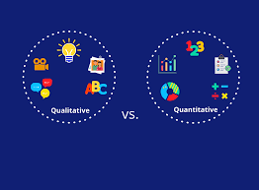
Quantitative variables
A discrete variable is a quantitative variable whose values are countable. Discrete variables usually result from counting.
A continuous variable is a quantitative variable that can assume any numerical value over an interval or over several intervals. A continuous variable usually results from making a measurement of some type.

Slide 6
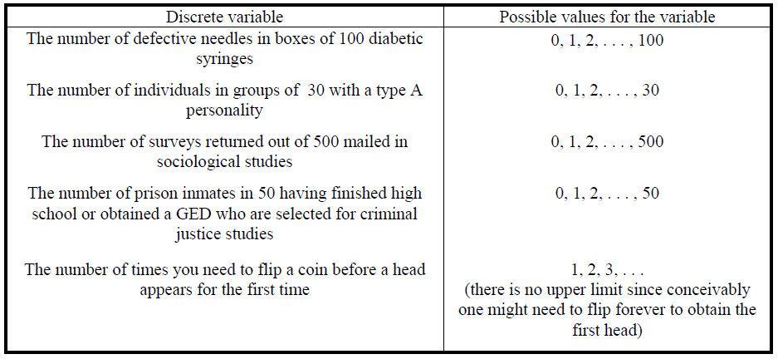
Quantitative variables: Discrete and Continuous

Slide 7
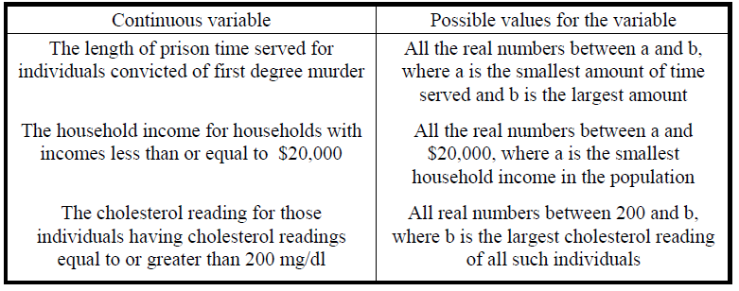
Quantitative variables: Discrete and Continuous

Slide 8

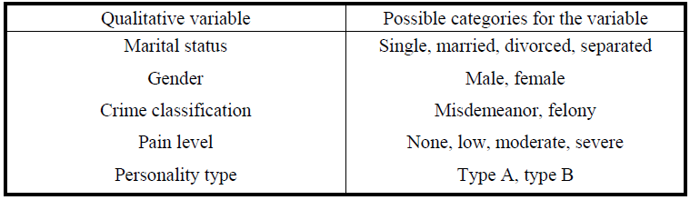
Qualitative variables

Slide 9
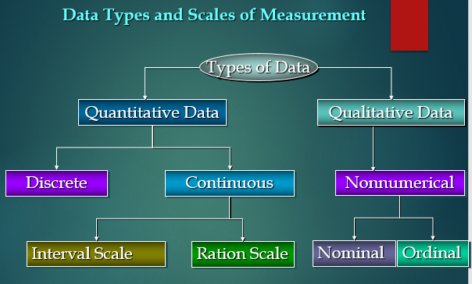

Slide 10
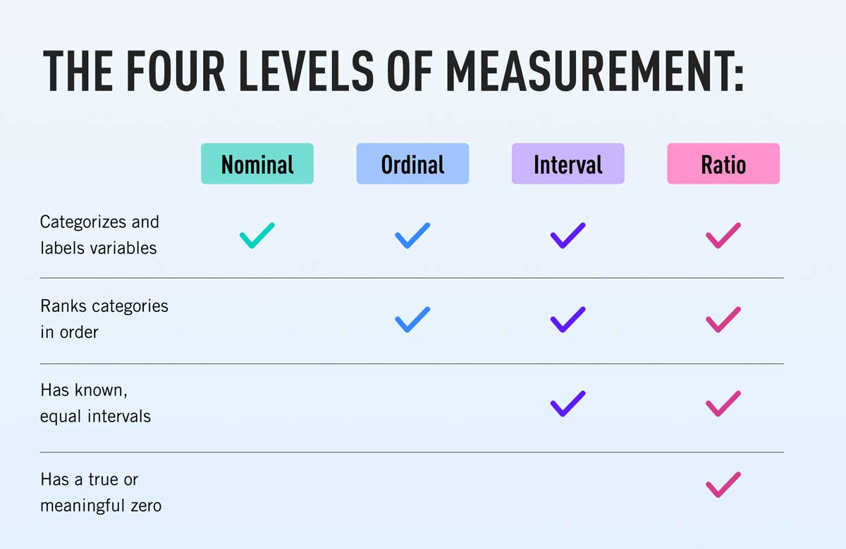
Level of Measurement
Data can be classified into four levels of measurement or scales of measurements.
Nominal
Ordinal
Interval
Ratio

Slide 11
Level of Measurement: Nominal, Ordinal, Interval and Ratio
The nominal scale applies to data that are used for category identification.
The nominal level of measurement is characterized by data that consist of names, labels, or categories only.
Nominal scale data cannot be arranged in an ordering scheme.
The arithmetic operations of addition, subtraction, multiplication and division are not performed for nominal data.

Slide 12
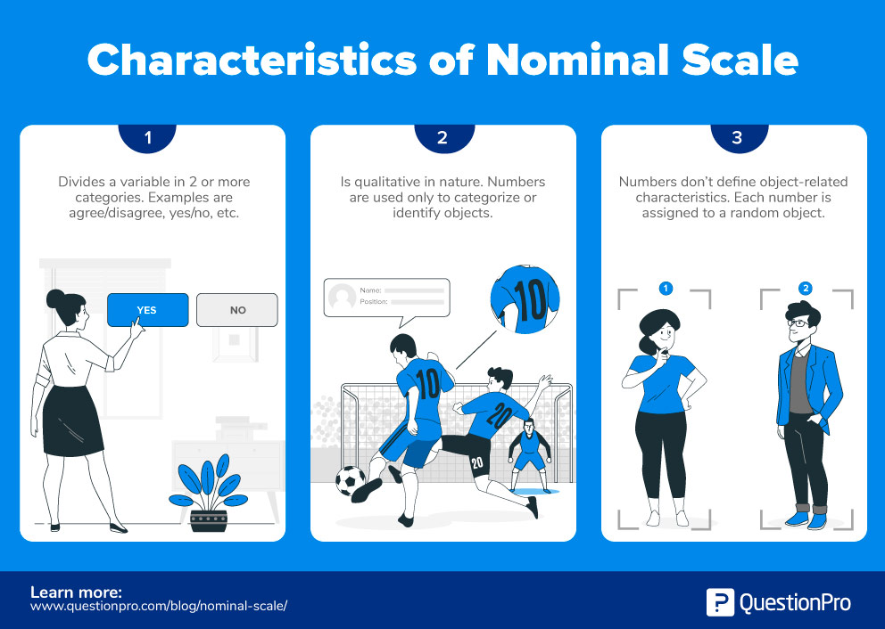

Slide 13
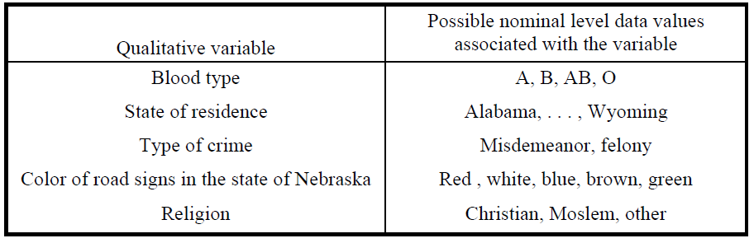
Level of Measurement: Nominal, Ordinal, Interval and Ratio

Slide 14
Level of Measurement: Nominal, Ordinal, Interval and Ratio
The ordinal scale applies to data that can be arranged in some order, but differences between data values either cannot be determined or are meaningless.
The ordinal level of measurement is characterized by data that applies to categories that can be ranked.
Ordinal scale data can be arranged in an ordering scheme.

Slide 15
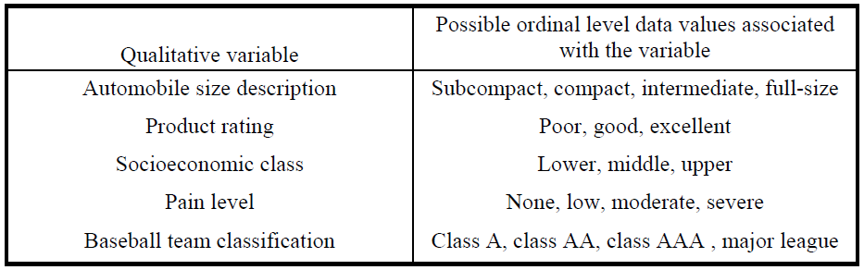
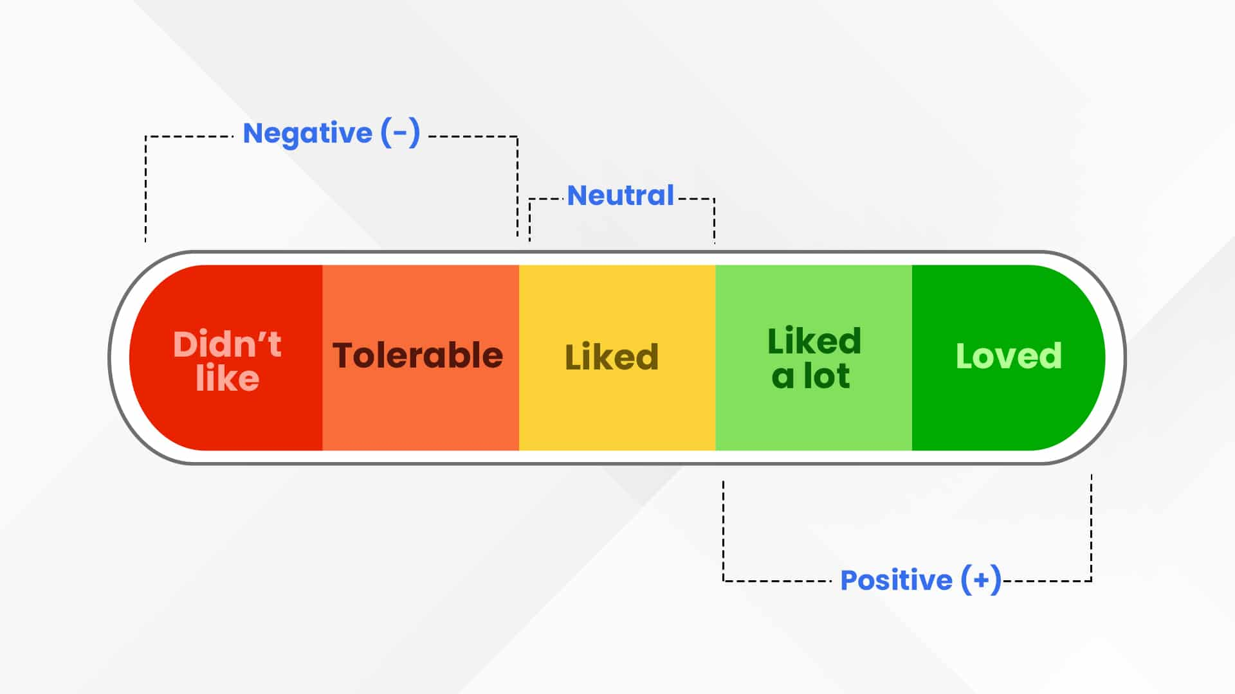
Level of Measurement: Nominal, Ordinal, Interval and Ratio

Slide 16
Level of Measurement: Nominal, Ordinal, Interval and Ratio
The interval scale applies to data that can be arranged in some order and for which differences in data values are meaningful.
The interval level of measurement results from counting or measuring.
Interval scale data can be arranged in an ordering scheme and differences can be calculated and interpreted.
The value zero is arbitrarily chosen for interval data and does not imply an absence of the characteristic being measured. Ratios are not meaningful for interval data.

Slide 17

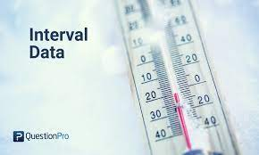
Level of Measurement: Nominal, Ordinal, Interval and Ratio
EXAMPLE 1:
Stanford-Binet IQ scores represent interval level data. Joe’s IQ score equals 100 and John’s IQ score equals 150. John has a higher IQ than Joe; that is, IQ scores can be arranged in order. John’s IQ score is 50 points higher than Joe’s IQ score; that is, differences can be calculated and interpreted. However, we cannot conclude that John is 1.5 times (150/100 = 1.5) more intelligent than Joe. An IQ score of zero does not indicate a complete lack of intelligence.
EXAMPLE 2
Temperatures represent interval level data. The high temperature on February 1 equaled 25ºF and the high temperature on March 1 equaled 50ºF. It was warmer on March 1 than it was on February 1. That is, temperatures can be arranged in order. It was 25º warmer on March 1 than on February 1. That is, differences may be calculated and interpreted. We cannot conclude that it was twice as warm on March 1 than it was on February 1. That is, ratios are not readily interpretable. A temperature of 0ºF does not indicate an absence of warmth.

Slide 18
Level of Measurement: Nominal, Ordinal, Interval and Ratio
The ratio scale applies to data that can be ranked and for which all arithmetic operations including division can be performed. Division by zero is, of course, excluded.
The ratio level of measurement results from counting or measuring.
Ratio scale data can be arranged in an ordering scheme and differences and ratios can be calculated and interpreted.
Ratio level data has an absolute zero and a value of zero indicates a complete absence of the characteristic of interest.

Slide 19
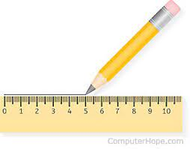
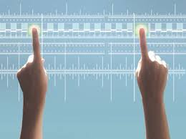
Level of Measurement: Nominal, Ordinal, Interval and Ratio
EXAMPLE 1
The grams of fat consumed per day for adults in the United States is ratio scale data. Joe consumes 50 grams of fat per day and John consumes 25 grams per day. Joe consumes twice as much fat as John per day, since 50/25 = 2. For an individual who consumes 0 grams of fat on a given day, there is a complete absence of fat consumed on that day. Notice that a ratio is interpretable and an absolute zero exists.
EXAMPLE 2
The number of 911 emergency calls in a sample of 50 such calls selected from a 24-hour period involving a domestic disturbance is ratio scale data. The number found on May 1 equals 5 and the number found on June 1 equals 10. Since 10/5 = 2, we say that twice as many were found on June 1 than were found on May 1. For a 24-hour period in which no domestic disturbance calls were found, there is a complete absence of such calls. Notice that a ratio is interpretable and an absolute zero exists.

Slide 20
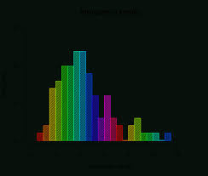
Histogram
A histogram is a graph that displays the classes on the horizontal axis and the frequencies of the classes on the vertical axis.
The frequency of each class is represented by a vertical bar whose height is equal to the frequency of the class.
A histogram is similar to a bar graph. However, a histogram utilizes classes or intervals and frequencies while a bar graph utilizes categories and frequencies.

Slide 21
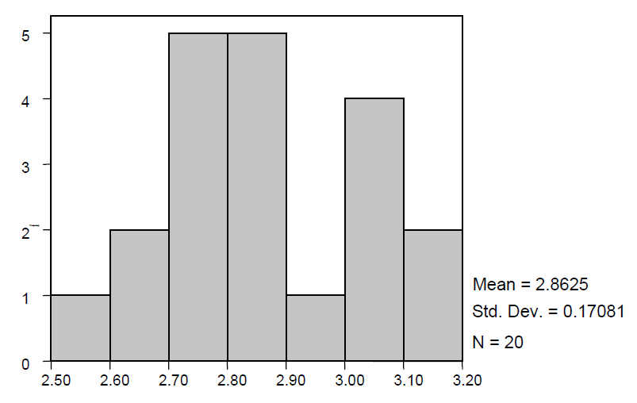
Histogram

Slide 22
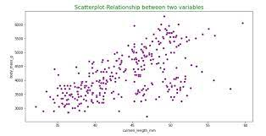
Scatter Plot
A scatter plot (aka scatter chart, scatter graph) uses dots to represent values for two different numeric variables.
The position of each dot on the horizontal and vertical axis indicates values for an individual data point.
Scatter plots are used to observe relationships between variables.

Slide 23
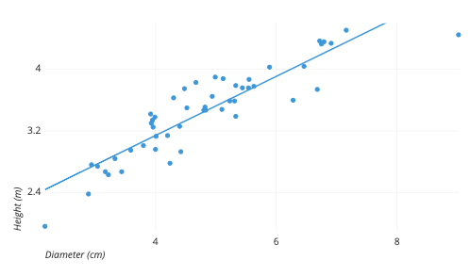
Scatter Plot

Slide 24
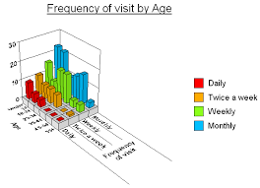
Cross Table
A cross table is a two-way table consisting of columns and rows.
It is also known as a pivot table or a multi-dimensional table.
Its greatest strength is its ability to structure, summarize and display large amounts of data

Slide 25
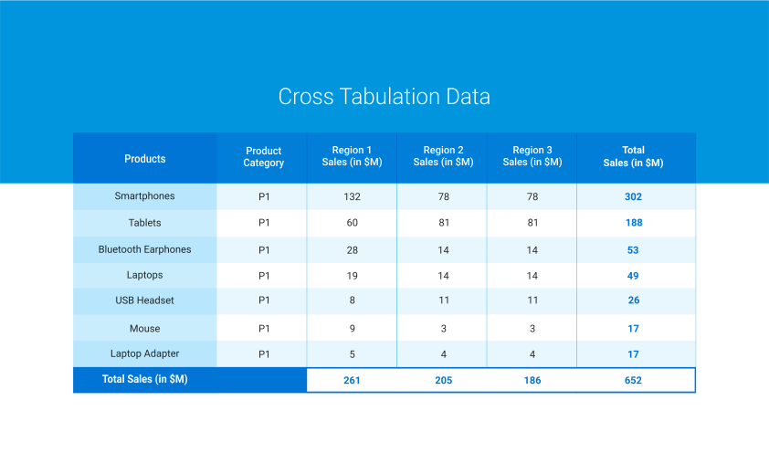
Cross Table

Slide 26
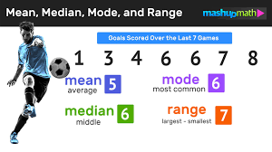
Measures of central tendency: Mean, Median and Mode
There are many different measures of central tendency. The three most widely used measures of central tendency are the mean, median, and mode.

Slide 27
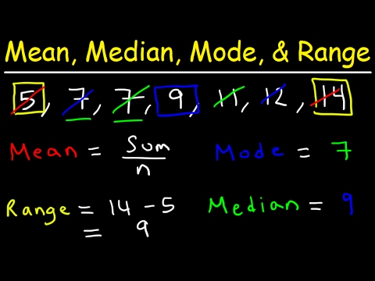
Measures of central tendency: Mean, Median and Mode
The median of a set of data is a value that divides the bottom 50% of the data from the top 50% of the data.
To find the median of a data set, first arrange the data in increasing order.
If the number of observations is odd, the median is the number in the middle of the ordered list. If the number of observations is even, the median is the mean of the two values closest to the middle of the ordered list.

Slide 28
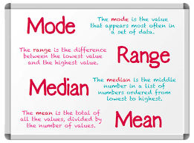
Measures of central tendency: Mean, Median and Mode
EXAMPLE
To find the median number of domestic disturbance calls per 24-hour period for the
data in Example 3.2 first arrange the data in increasing order.
19 22 23 25 27 29 29 30 30 34 36 37 37 38 38
40 40 40 44 45 46 46 47 47 49 50 50 56 56 58
The two values closest to the middle are 38 and 40. The median is the mean of these two values or 39.

Slide 29
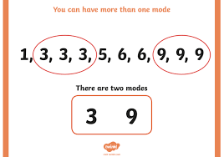
Measures of central tendency: Mean, Median and Mode
The mode is the value in a data set that occurs the most often.
If no such value exists, we say that the data set has no mode.
If two such values exist, we say the data set is bimodal.
If three such values exist, we say the data set is trimodal.
There is no symbol that is used to represent the mode.

Slide 30
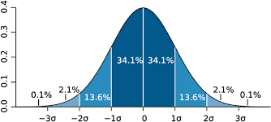
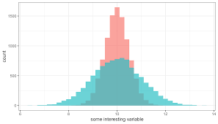
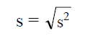
Spread of data
The variance and the standard deviation of a data set measures the spread of the data about the mean of the data set. The variance of a sample of size n is represented by s2 and is given by
Standard Deviation is

Slide 31
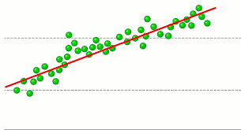
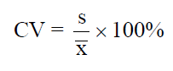
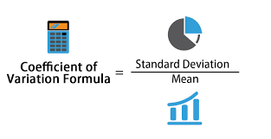
Spread of data
The coefficient of variation is equal to the standard deviation divided by the mean. The result is usually multiplied by 100 to express it as a percent.

Slide 32
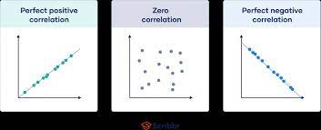
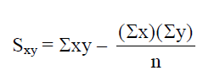
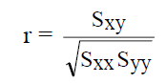
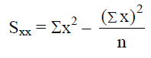
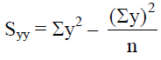
Correlation
The linear correlation coefficient, also known as simply the correlation coefficient, is a measure of the strength of the linear association between two variables.
The correlation coefficient is also sometimes referred to as the Pearson correlation coefficient.

Slide 33
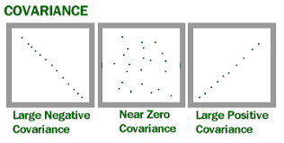
Covariance
Covariance measures the direction of the relationship between two variables.
A positive covariance means that both variables tend to be high or low at the same time.
A negative covariance means that when one variable is high, the other tends to be low.

Slide 34
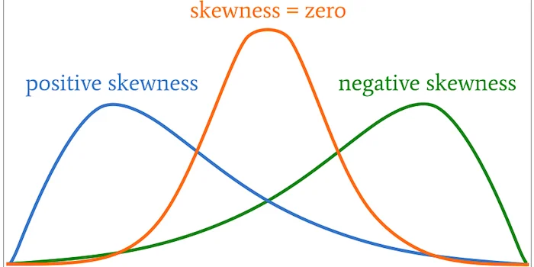
Skewness
Skewness is a measure of symmetry in a distribution.
Actually, it’s more correct to describe it as a measure of lack of symmetry.
A standard normal distribution is perfectly symmetrical and has zero skew.
However, other distributions don’t have zero skew.
Therefore, we need a way to calculate how much the distribution is skewed.

Slide 35
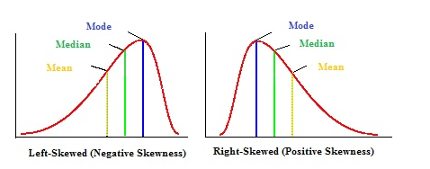
Skewness

